Slide 1
An Integrated Phylogeographic Assessment of the Bantu Migration
Colby T. Ford

Slide 2

About Me
Awards:
2007 – 2011 Gates Foundation Grant
2012 – 2014 Coffey Scholar
2012 – 2014 C.L. Robbins Scholar
2015 – 2016 Wayland H. Cato Fellowship
Affiliations:
Society for Industrial and Applied Mathematics
American Statistical Association
Society for Anthropological Sciences
UNCC Data Science Initiative Advisory Board
Northeastern University LEVEL Advisory Board
Microsoft Preferred Partner
Data Science and Advanced Analytics
Bachelor of Arts
Applied Mathematics
Magna Cum Laude
Master of Science
Data Science and Business Analytics
First Graduate
Doctor of Philosophy (Current Program)
Bioinformatics and Computational Biology

Slide 3




Presentation Outline
Introduction and Background
Migratory Model Generation
Dimensionality Reduction and Machine Learning
Conclusion and Future Work

Slide 4
Introduction and Background

Slide 5
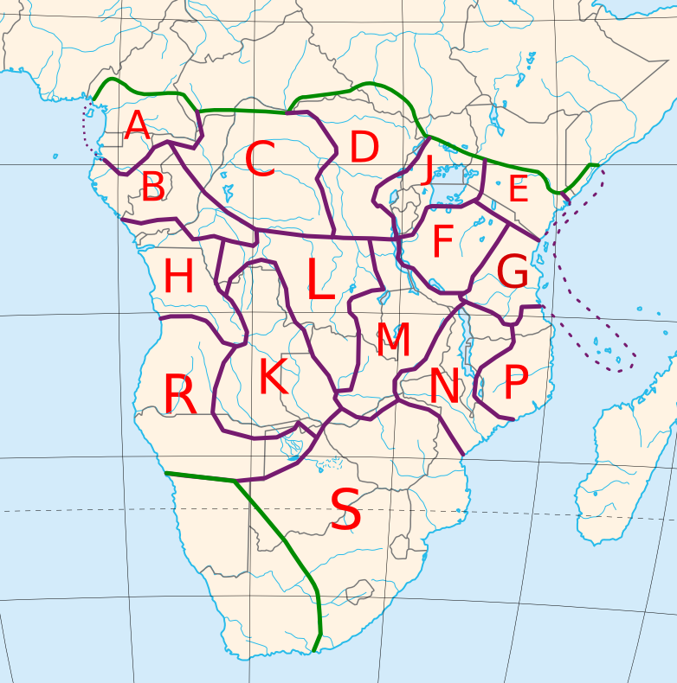
Introduction and Background
Bantu:
A group of more than 150 million people on the continent of Africa
Accounts for ~1/3 of the population on the continent
Covers the area from southern Cameroon to most of South Africa
Consists of about 600 languages (including dialects)
Guthrie Zones:
Cultural boundaries defined by Malcom Guthrie (1948, 1967-1971)
Hierarchy (Maho, 2009):
16 Zones
83 Decades (Groups)
682 Units (Language and Dialect Clusters)
Example: A32a Banoo
(Edricson, 2007)

Slide 6
Differing Migration Models | The Problem
Consensus that the group started in present-day Cameroon
After that, there is a considerable amount of disagreement for the expansion trajectory
Researchers from various disciplines have published their findings of the Bantu migration, but all used different data sets
These papers show very different migratory paths

Slide 7
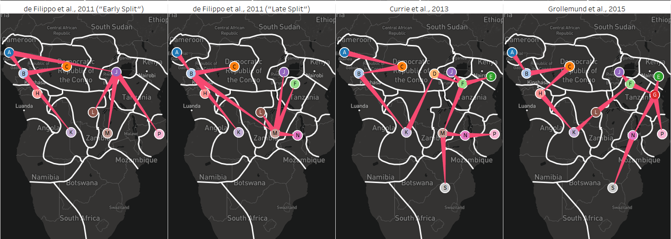
(a)
(b)
(c)
(d)
By: de Filippo et al., 2011
Cesare de Filippo – Max Planck Institute for Evolutionary Anthropology, Dept. of Evolutionary Genetics
Data: Autosomal STR loci, Lexical
Split the data into 6 super groups such as Pygmy, Afro-Asiatic, Niger-Congo, etc.
Analyzed correlations and distances between genetic and lexical data
By: Currie et al., 2013
Thomas E. Currie– U. of Exeter, Cultural Evolution and Anthropology
Data: Lexical
By: Grollemund et al., 2015
Rebecca Grollemund– U. of Missouri, Depts. of Anthropology and English
Data: Lexical

Slide 8
Differing Migration Models | Hypothesis
The de Filippo models show two different points of divergence:
Early split beginning in present-day Cameroon
Later split below the Congolese rainforest region, following a more linear migration path.
By combining the cultural and genomic data to create a single migratory path, this hypothesis will be tested.
"Bantu expansion can be characterized by a primary split in lineages, which occurred early on and prior to the population spreading south through the now Congolese forest region."

Slide 9
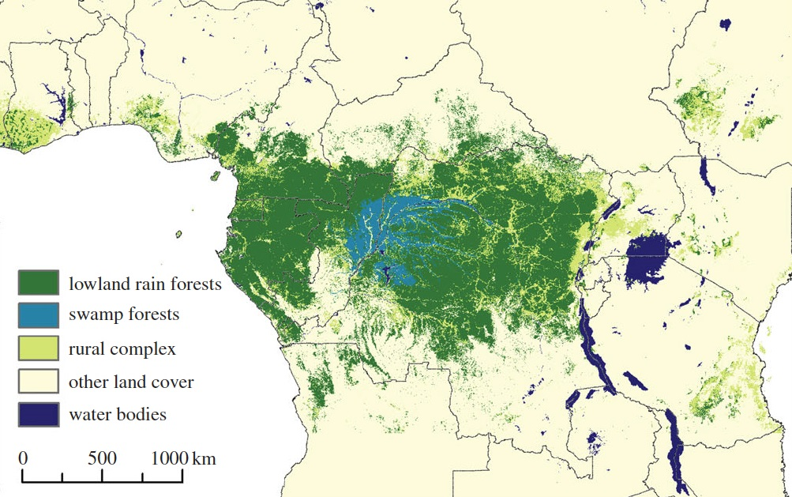
The Congolese Forest | Geographic Barrier
A sub-hypothesis around the migratory path is that the Congolese forest has provided a geographic boundary of sorts, around which the Bantu peoples migrated
Runs through southern Cameroon, Gabon, Republic of Congo, and the Democratic Republic of Congo
(Butler, 2016)

Slide 10
Migratory Model Generation

Slide 11
Bantu Migration | Materials and Methods
Data Sources and Organization
Alignment and Phylogeny Creation
21 Separate Sources:
9 mtDNA
57 Bantu Groups + 2 outgroups
9 Y-chromosomal
49 Bantu Groups + 2 outgroups
1 Cultural
91 Bantu Groups + 12 outgroups
2 Linguistic
93 Bantu Groups + 12 outgroups
Multiple Sequence Alignment:
MAFFT (Katoh, 2002)
Tree Generation:
PAUP* (Swofford, 2008)
RAxML (Stamatakis, 2014)
POY5 (Wheeler, 2013)
TNT (Goloboff, 2008)
Notes:
Outgroups: Nigerian Languages (Ekoi People, Yoruba, Efik, etc.)
Cultural Data Source: Ethnographic Atlas Codebook (115 Cultural Traits)

Slide 12
Bantu Migration | Materials and Methods
Data Sources and Organization
Alignment and Phylogeny Creation
21 Separate Sources:
9 mtDNA
57 Bantu Groups + 2 outgroups
9 Y-chromosomal
49 Bantu Groups + 2 outgroups
1 Cultural
91 Bantu Groups + 12 outgroups
Multiple Sequence Alignment:
MAFFT (Katoh, 2002)
Tree Generation:
PAUP* (Swofford, 2008)
RAxML (Stamatakis, 2014)
POY5 (Wheeler, 2013)
TNT (Goloboff, 2008)

Slide 13
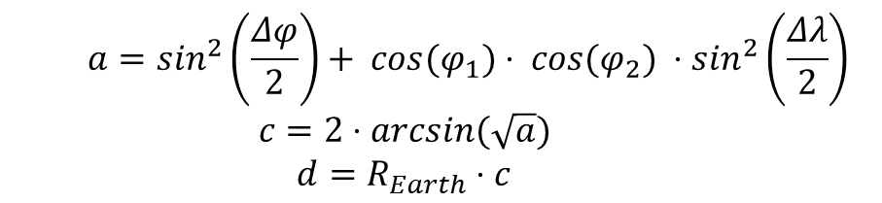
Bantu Migration | Haversine Distance
“As the crow flies…”
Haversine Distance vs. Euclidean
The Haversine Formula
Using the latitude and longitude coordinates between two points, the distance between them can be calculated.
Given that the points are on the surface of a sphere (the Earth), the geometry is a little different.
The Euclidean distance (the flat, straight distance) between two distant points on a sphere ignores the curvature of the surface.
So, Haversine distance is more accurate, especially at the continental-scale.
Latitudes
Longitudes
$$a=\sin^{2}\left(\frac{Δφ}{2}\right)+ cos⁡(φ_{1})⋅ cos⁡(φ_{2}) ⋅\sin^{2}\left(\frac{Δλ}{2}\right)$$
$$c=2⋅arcsin⁡(\sqrt{a})$$
$$d=R_{Earth}⋅c$$
d
(van Brummelen, 2013)

Slide 14
Bantu Migration | Sankoff Matrix
Zone | A | B | C | D | E | F | G | H | J | K | L | M | N | P | R | S | Z
A | 0 | 555 | 1269 | 1977 | 3171 | 2611 | 3176 | 1068 | 2329 | 2151 | 2198 | 2702 | 3111 | 3624 | 2098 | 3524 | 395
B | 555 | 0 | 928 | 1606 | 2812 | 2215 | 2762 | 513 | 1974 | 1597 | 1685 | 2171 | 2596 | 3133 | 1585 | 2970 | 936
C | 1269 | 928 | 0 | 708 | 1909 | 1342 | 1910 | 850 | 1065 | 1399 | 1122 | 1655 | 1980 | 2423 | 1834 | 2680 | 1499
D | 1977 | 1606 | 708 | 0 | 1207 | 637 | 1209 | 1381 | 370 | 1377 | 831 | 1273 | 1462 | 1802 | 2053 | 2384 | 2191
E | 3171 | 2812 | 1909 | 1207 | 0 | 624 | 398 | 2543 | 844 | 2140 | 1529 | 1572 | 1359 | 1220 | 2931 | 2497 | 3352
F | 2611 | 2215 | 1342 | 637 | 624 | 0 | 573 | 1923 | 344 | 1567 | 943 | 1125 | 1094 | 1259 | 2343 | 2186 | 2827
G | 3176 | 2762 | 1910 | 1209 | 398 | 573 | 0 | 2430 | 900 | 1873 | 1296 | 1235 | 973 | 843 | 2669 | 2106 | 3400
H | 1068 | 513 | 849 | 1381 | 2543 | 1923 | 2430 | 0 | 1744 | 1086 | 1244 | 1696 | 2139 | 2702 | 1141 | 2457 | 1446
J | 2329 | 1974 | 1065 | 370 | 844 | 344 | 900 | 1744 | 0 | 1599 | 990 | 1312 | 1377 | 1599 | 2330 | 2415 | 2521
K | 2151 | 1597 | 1399 | 1377 | 2140 | 1567 | 1873 | 1086 | 1599 | 0 | 645 | 755 | 1224 | 1830 | 796 | 1376 | 2521
L | 2198 | 1685 | 1122 | 831 | 1529 | 923 | 1296 | 1244 | 990 | 625 | 0 | 533 | 913 | 1458 | 1404 | 1590 | 2516
M | 2702 | 2171 | 1655 | 1273 | 1572 | 1125 | 1235 | 1696 | 1312 | 755 | 533 | 0 | 470 | 1075 | 1510 | 1113 | 3034
N | 3111 | 2596 | 1980 | 1462 | 1359 | 1094 | 973 | 2139 | 1377 | 1224 | 913 | 470 | 0 | 608 | 1959 | 1139 | 3423
P | 3624 | 3133 | 2423 | 1802 | 1220 | 1259 | 843 | 2702 | 1599 | 1830 | 1458 | 1075 | 608 | 0 | 2562 | 1479 | 3909
R | 2098 | 1585 | 1834 | 2053 | 2931 | 2343 | 2669 | 1141 | 2330 | 796 | 1404 | 1510 | 1959 | 2562 | 0 | 1695 | 2493
S | 3524 | 2970 | 2680 | 2384 | 2497 | 2186 | 2106 | 2457 | 2415 | 1376 | 1590 | 1113 | 1139 | 1479 | 1695 | 0 | 3896
Z | 395 | 936 | 1499 | 2191 | 3352 | 2827 | 3400 | 1446 | 2521 | 2521 | 2516 | 3034 | 3423 | 3909 | 2493 | 3896 | 0
Using the Haversine formula, the distance is calculated between the centroids of each Guthrie zone.
This is converted into a symmetric matrix for use as the Sankoff matrix in the phylogenetic analyses.

Slide 15
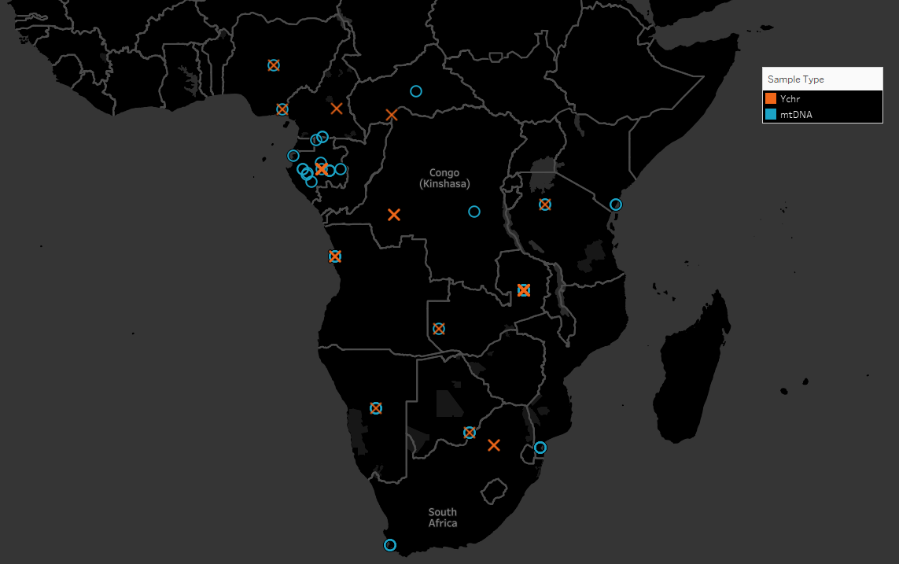
Bantu Migration | Data Samples
Guthrie Zone | mtDNA | Ychr | Cultural | Linguistic | Total
A | 4 | 3 | 5 | 5 | 17
B | 8 | 13 | 5 | 5 | 31
C | 2 | 2 | 11 | 11 | 26
D | 0 | 0 | 5 | 5 | 10
E | 2 | 0 | 6 | 7 | 15
F | 0 | 1 | 3 | 3 | 7
G | 2 | 0 | 7 | 7 | 16
H | 1 | 2 | 6 | 6 | 15
J | 0 | 0 | 9 | 9 | 18
K | 7 | 7 | 3 | 4 | 21
L | 3 | 3 | 2 | 2 | 10
M | 6 | 5 | 6 | 6 | 23
N | 4 | 3 | 6 | 6 | 19
P | 0 | 0 | 2 | 2 | 4
R | 3 | 3 | 3 | 3 | 12
S | 14 | 7 | 12 | 12 | 45
Z (Outgroup) | 2 | 2 | 12 | 12 | 28
Total | 58 | 51 | 103 | 105 | 317
Zone Coverage | 75% | 69% | 100% | 100% | 100%

Slide 16
Bantu Migration | Data Samples
Guthrie Zone | mtDNA | Ychr | Cultural | Total
A | 4 | 3 | 5 | 12
B | 8 | 13 | 5 | 26
C | 2 | 2 | 11 | 15
D | 0 | 0 | 5 | 5
E | 2 | 0 | 6 | 8
F | 0 | 1 | 3 | 4
G | 2 | 0 | 7 | 9
H | 1 | 2 | 6 | 9
J | 0 | 0 | 9 | 9
K | 7 | 7 | 3 | 17
L | 3 | 3 | 2 | 8
M | 6 | 5 | 6 | 17
N | 4 | 3 | 6 | 13
P | 0 | 0 | 2 | 2
R | 3 | 3 | 3 | 9
S | 14 | 7 | 12 | 33
Z (Outgroup) | 2 | 2 | 12 | 16
Total | 58 | 51 | 103 | 212
Zone Coverage | 75% | 69% | 100% | 100%

Slide 17












Bantu Migration | Tree Generation Pipeline
Input Data
Tree Generation
Model Output
Y-chromosomal STR
POY4
PAUP
.nexus
.tree
Mitochondrial DNA
MAFFT
POY4
PAUP
.fasta
.fasta
.tree
Cultural
POY4
PAUP
.nexus
.tree
Combined
POY4
PAUP
MAFFT | (Katoh, 2002)
PAUP | (Swofford, 2008)
POY | (Wheeler et al., 2013)
.nexus
.tree

Slide 18







Bantu Migration | Tree Generation Pipeline
Tree Generation Software
Y-Chromosomal
.nex
PAUP
Mitochondrial DNA
.fasta
MAFFT
RAxML
POY
Cultural
TNT
.nex
MAFFT | (Katoh, 2002)
PAUP | (Swofford, 2008)
RAxML | (Stamatakis, 2014)
POY | (Wheeler et al., 2013)
TNT | (Goloboff et al., 2008)

Slide 19
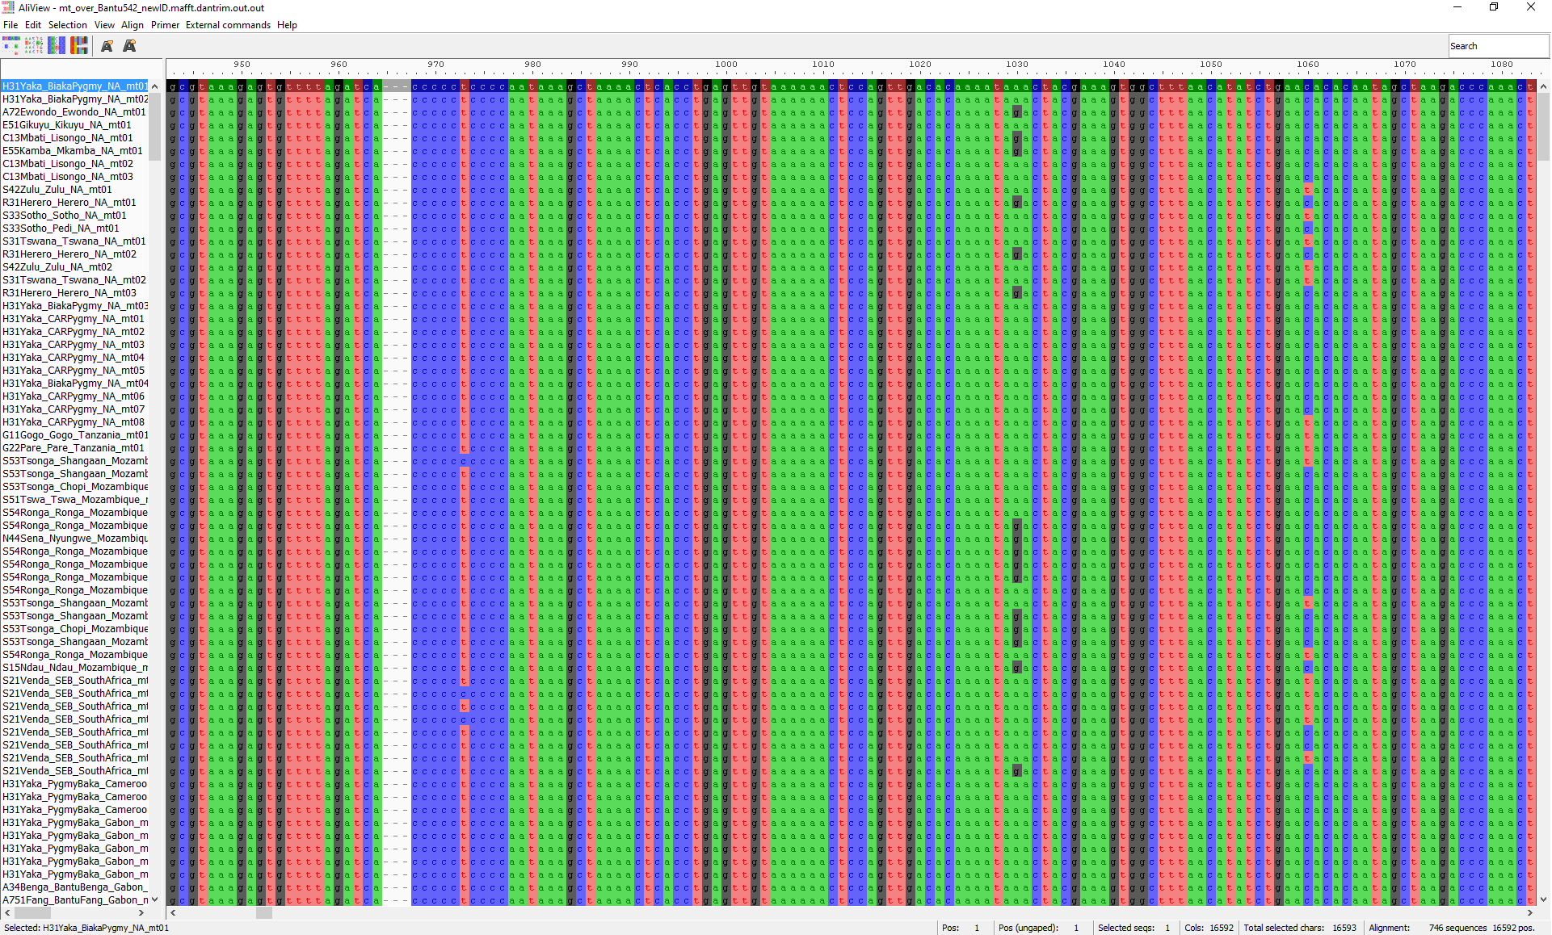
Multiple Sequence Alignment | mtDNA Data
Multiple Sequence Alignment Performed in MAFFT
Default Settings
--thread 20
Very few indels
Curated some of the obvious quality errors out
May try other alignment algorithms or parameter settings
Notes:
Multiple Alignment using Fast Fourier Transforms
-Took out D characters, which are one of G, A, or T.
DEFAULT OPTIONS
Algorithm
--auto
Automatically selects an appropriate strategy from L-INS-i, FFT-NS-i and FFT-NS-2, according to data size. Default: off (always FFT-NS-2)
--6merpair
Distance is calculated based on the number of shared 6mers. Default: on
--globalpair
All pairwise alignments are computed with the Needleman-Wunsch algorithm. More accurate but slower than --6merpair. Suitable for a set of globally alignable sequences. Applicable to up to ~200 sequences. A combination with --maxiterate 1000 is recommended (G-INS-i). Default: off (6mer distance is used)
--localpair
All pairwise alignments are computed with the Smith-Waterman algorithm. More accurate but slower than --6merpair. Suitable for a set of locally alignable sequences. Applicable to up to ~200 sequences. A combination with --maxiterate 1000 is recommended (L-INS-i). Default: off (6mer distance is used)
--genafpair
All pairwise alignments are computed with a local algorithm with the generalized affine gap cost (Altschul 1998). More accurate but slower than --6merpair. Suitable when large internal gaps are expected. Applicable to up to ~200 sequences. A combination with --maxiterate 1000 is recommended (E-INS-i). Default: off (6mer distance is used)
--fastapair
All pairwise alignments are computed with FASTA (Pearson and Lipman 1988). FASTA is required. Default: off (6mer distance is used)
--weighti number
Weighting factor for the consistency term calculated from pairwise alignments. Valid when either of --globalpair, --localpair, --genafpair, --fastapair or --blastpair is selected. Default: 2.7
--retree number
Guide tree is built number times in the progressive stage. Valid with 6mer distance. Default: 2
--maxiterate number
number cycles of iterative refinement are performed. Default: 0
--fft
Use FFT approximation in group-to-group alignment. Default: on
--nofft
Do not use FFT approximation in group-to-group alignment. Default: off
--noscore
Alignment score is not checked in the iterative refinement stage. Default: off (score is checked)
--memsave
Use the Myers-Miller (1988) algorithm. Default: automatically turned on when the alignment length exceeds 10,000 (aa/nt).
--parttree
Use a fast tree-building method (PartTree, Katoh and Toh 2007) with the 6mer distance. Recommended for a large number (> ~10,000) of sequences are input. Default: off
--dpparttree
The PartTree algorithm is used with distances based on DP. Slightly more accurate and slower than --parttree. Recommended for a large number (> ~10,000) of sequences are input. Default: off
--fastaparttree
The PartTree algorithm is used with distances based on FASTA. Slightly more accurate and slower than --parttree. Recommended for a large number (> ~10,000) of sequences are input. FASTA is required. Default: off
--partsize number
The number of partitions in the PartTree algorithm. Default: 50
--groupsize number
Do not make alignment larger than number sequences. Valid only with the --*parttree options. Default: the number of input sequences
Parameter
--op number
Gap opening penalty at group-to-group alignment. Default: 1.53
--ep number
Offset value, which works like gap extension penalty, for group-to-group alignment. Default: 0.123
--lop number
Gap opening penalty at local pairwise alignment. Valid when the --localpair or --genafpair option is selected. Default: -2.00
--lep number
Offset value at local pairwise alignment. Valid when the --localpair or --genafpair option is selected. Default: 0.1
--lexp number
Gap extension penalty at local pairwise alignment. Valid when the --localpair or --genafpair option is selected. Default: -0.1
--LOP number
Gap opening penalty to skip the alignment. Valid when the --genafpair option is selected. Default: -6.00
--LEXP number
Gap extension penalty to skip the alignment. Valid when the --genafpair option is selected. Default: 0.00
--bl number
BLOSUM number matrix (Henikoff and Henikoff 1992) is used. number=30, 45, 62 or 80. Default: 62
--jtt number
JTT PAM number (Jones et al. 1992) matrix is used. number>0. Default: BLOSUM62
--tm number
Transmembrane PAM number (Jones et al. 1994) matrix is used. number>0. Default: BLOSUM62
--aamatrix matrixfile
Use a user-defined AA scoring matrix. The format of matrixfile is the same to that of BLAST. Ignored when nucleotide sequences are input. Default: BLOSUM62
--fmodel
Incorporate the AA/nuc composition information into the scoring matrix. Default: off

Slide 20
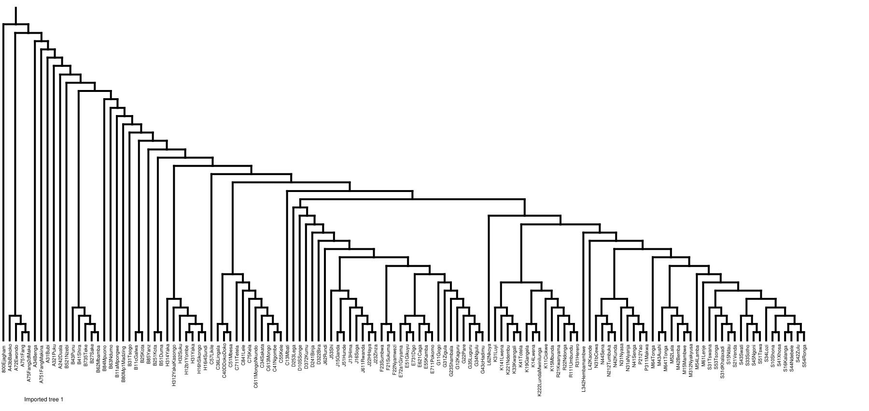
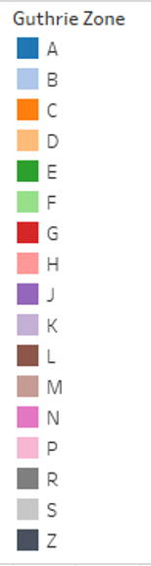
Individual Tree: mtDNA Data

Slide 21
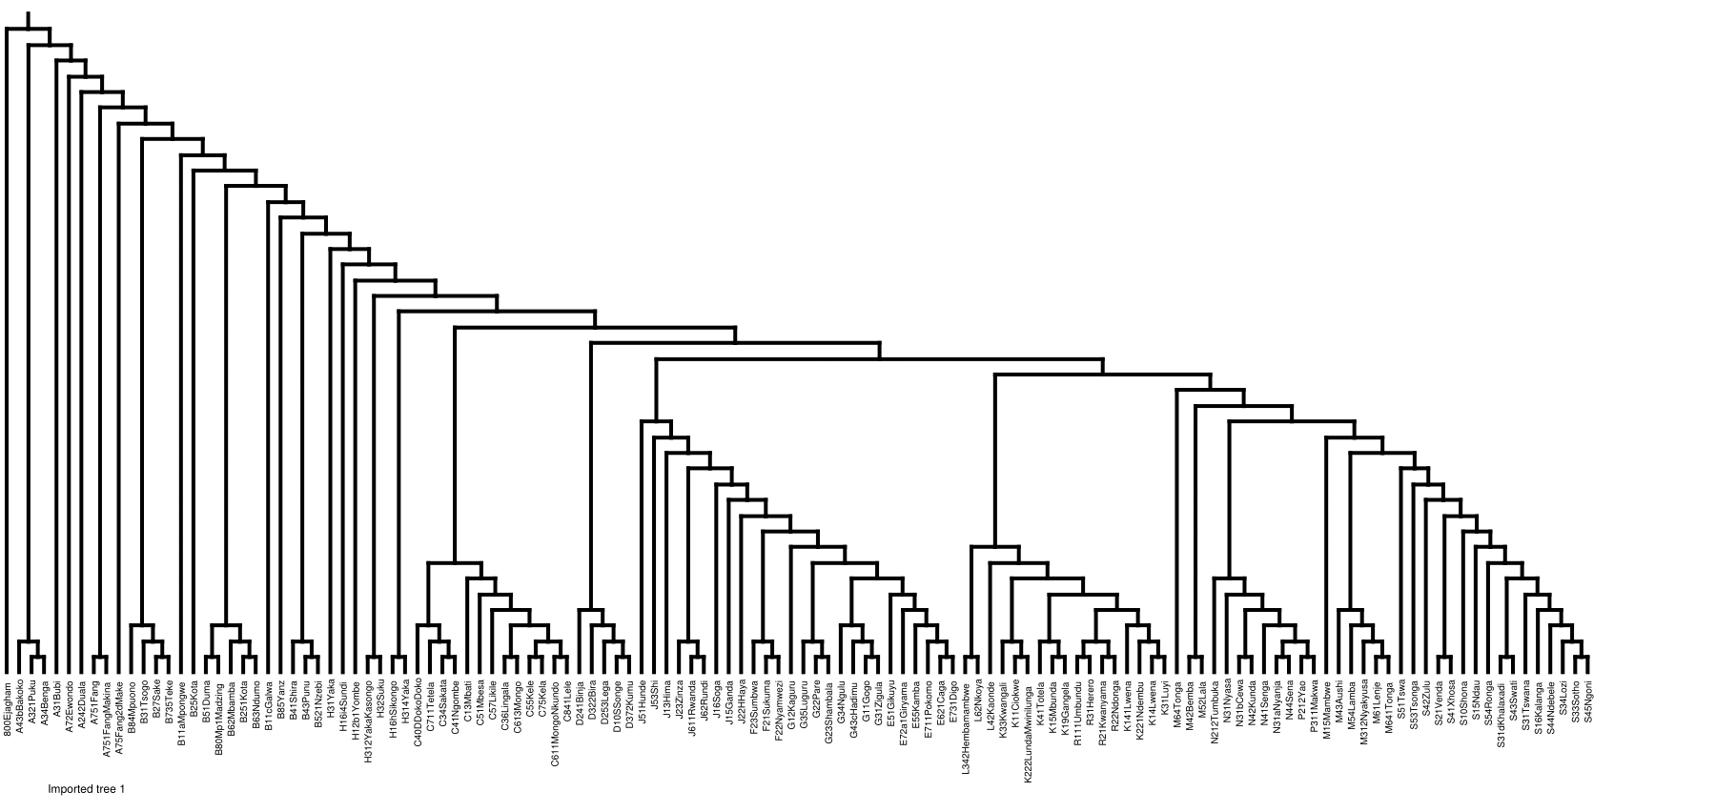
Individual Tree: Ychr Data

Slide 22
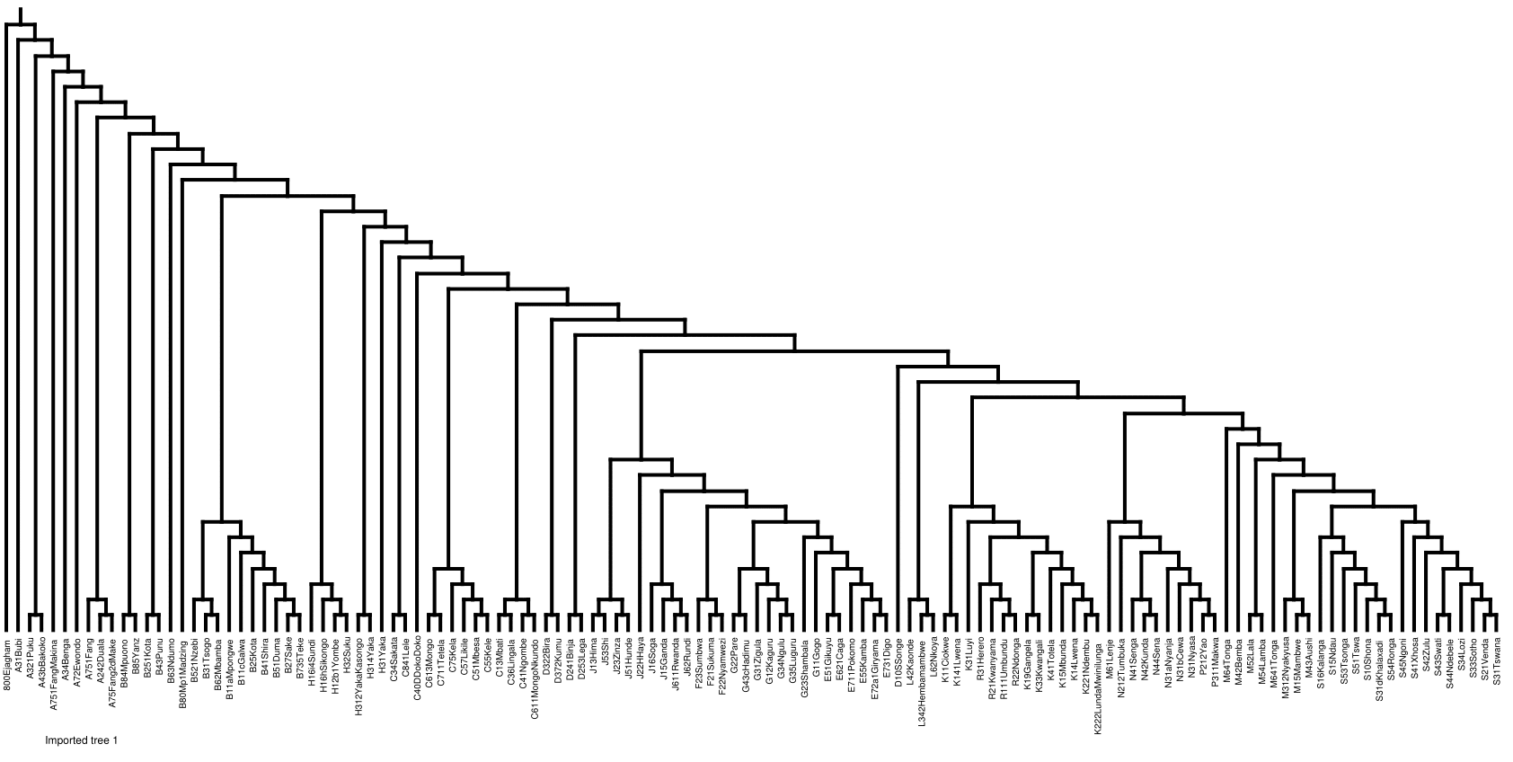
Individual Tree: Cultural Data

Slide 23
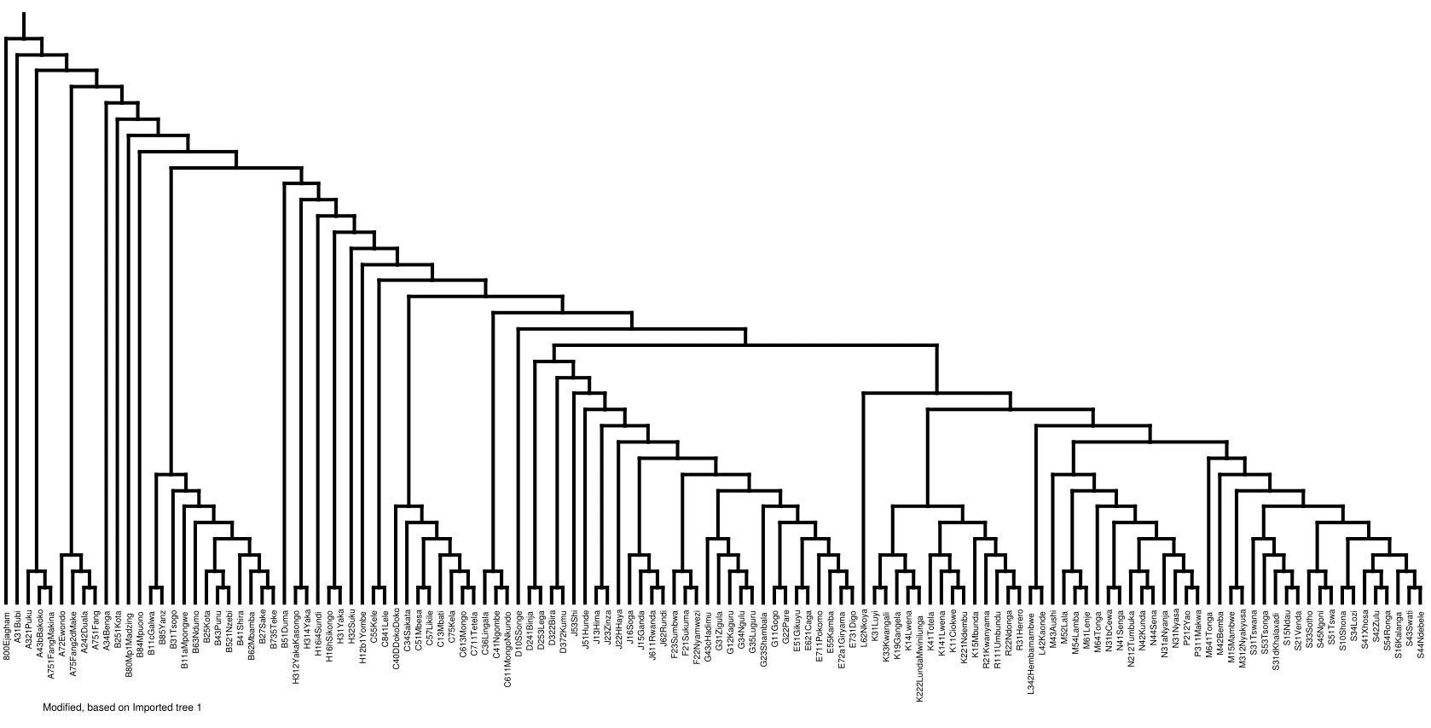
Combined Tree: mtDNA + Ychr + Cultural Data

Slide 24
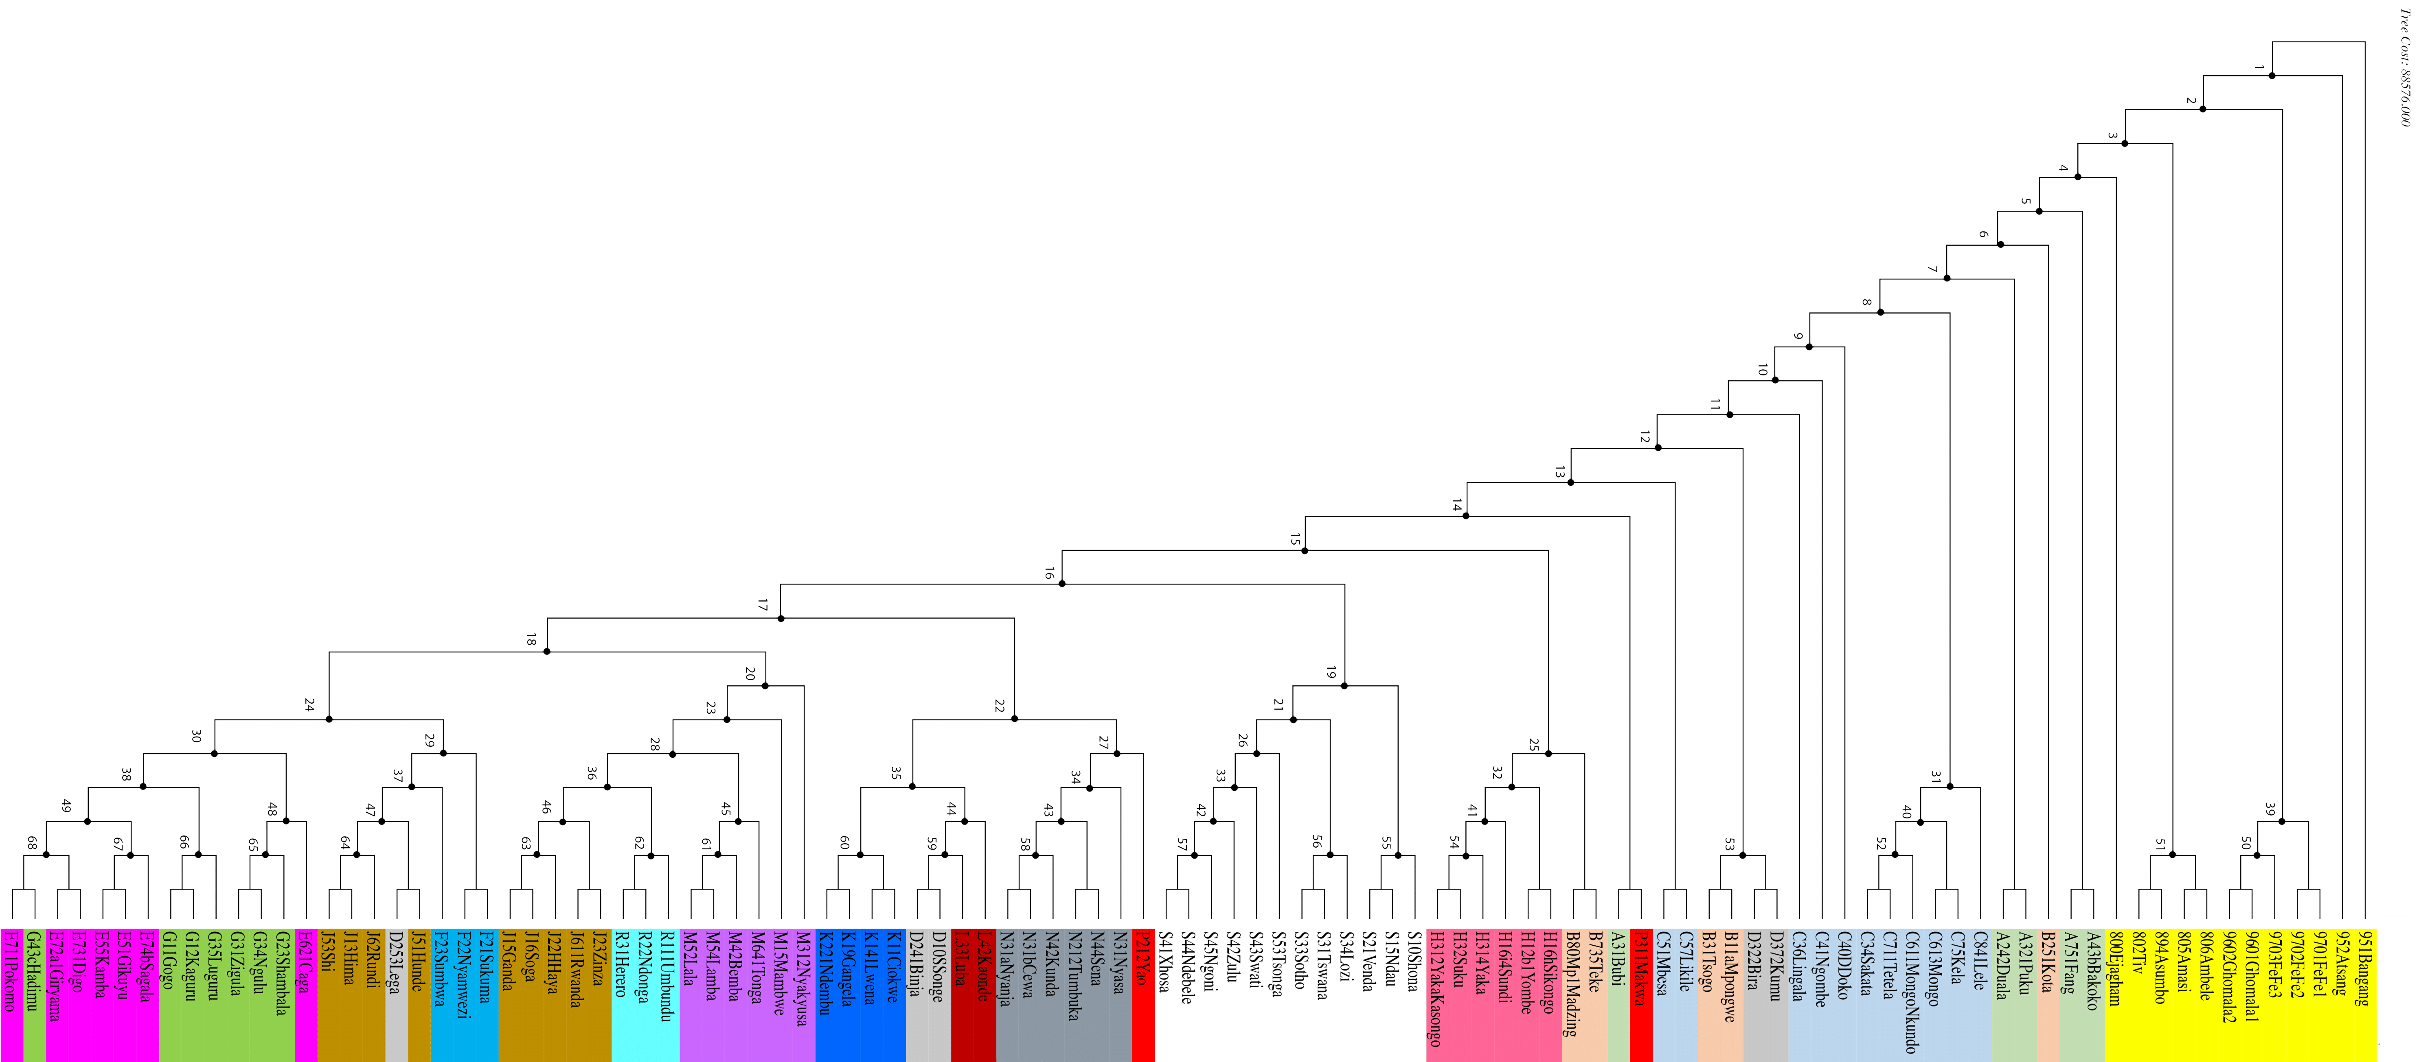
Individual Tree: Linguistic Data
Whiteley et al. (2017)

Slide 25
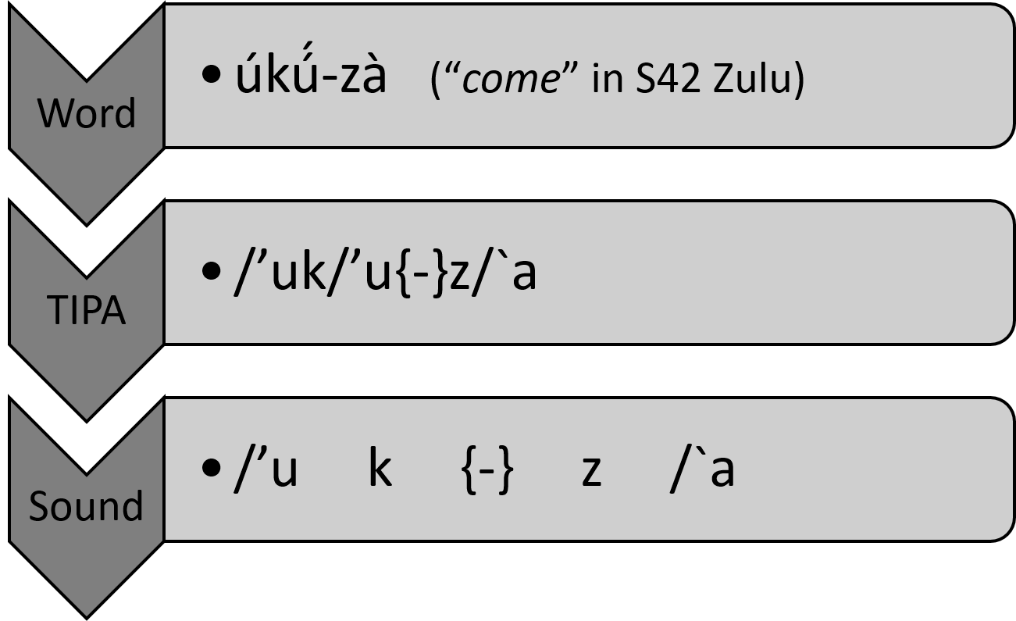
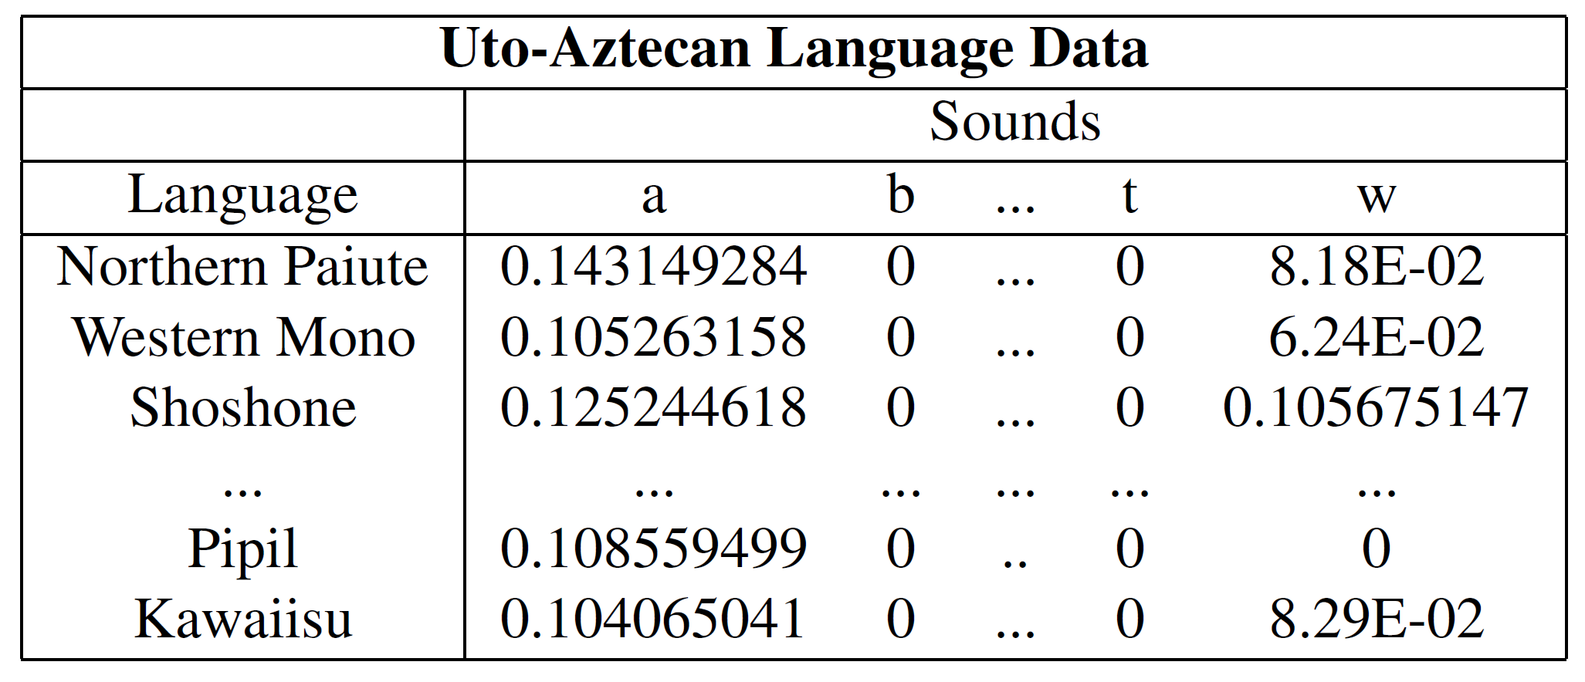
Sound Data
After conversion to TIPA and broken down into constituent sounds, frequency information is calculated for each sound.
Data Statistics:
Bantu:
255 Sounds
105 Languages
Uto-Aztecan
142 Sounds
40 Languages

Slide 26
Bantu Migration | To Do List
Data Organization and Aggregation
Preparation of Geographic Data
Roll-up to the Guthrie Zone Level:
Cleanse and integrate geographic information
Latitude and Longitude values for each Guthrie Zone center
Configure shapefile to map cultural zones instead of political boundaries
This information will be used with mapping packages to generate comparable migratory visualizations to previous publications.
C13Mbati_Lisongo_NA_mt01
C13Mbati_Lisongo_NA_mt02
C13Mbati_Lisongo_NA_mt03
C13Mbati
C
Ensure Taxa Name Cohesion
C13Mbati vs. C13_Mbati vs. C13 Mbati

Slide 27
Dimensionality Reduction and Machine Learning

Slide 28
Bantu Migration | Database Creation
Making the Tables
SQL Ease of Use
Using Microsoft SQL Server, four database tables are created to house the data in a tabular form:
mtDNA
Ychr
Cultural
Geographic Information
Using the TaxaID as the key on which to join, each table can be joined to create combined datasets.
Database views are created to house the combined datasets for further analysis.
Note: Some manual matching of TaxaIDs was necessary due to style differences between datasets.

Slide 29
Cultural | Example
TaxaID | A242Duala
GuthrieZone | A
Taxa | A242Duala
BCMID | A24 2
Cultural_EthnogAtlas | 0101818559189B293919997…
mtDNA | Example
TaxaID | H31Yaka
GuthrieZone | H
Taxa | H31Yaka_BiakaPygmy_NA_mt01
BCMID | H31
SampleID | mt01
mtDNA | gatcacaggtctatcacccta…
Geographic Information | Example
GuthrieZone | B
BCM ID_FULL | B80L1
BCM ID_SIMPLE | B80
BCM ID_SUFFIX | L1
BCM ID_INDEX | 1
BCM NAME | Lwel 1
BCM FULL NAME | B80L1Lwel 1
Longitude | -4.45
Latitude | 20.1
Ychr | Example
TaxaID | A34Benga
GuthrieZone | A
Taxa | A34Benga_Benga_Gabon_chry01
BCMID | A34
SampleID | chry01
Ychr_STR | EJGJBPDBFEBB
Notes:
Outgroups: Nigerian Languages (Ekoi People, Yoruba, Efik, etc.)
Cultural Data Source: Ethnographic Atlas Codebook (115 Cultural Traits)

Slide 30
Bantu Migration | Data Preparation
❶ Load data from SQL tables using view
TaxaID | … | mtDNA | Ychr_STR | Cultural_EthnogAtlas
A751Fang | … | gatcag…gct | DHHKANEBGEBC | 2231618755185B6…
❷ Split sequence strings and assign each letter to its own variable
TaxaID | … | mtDNA.pos1 | … | mtDNA.pos16590 | Ychr_STR.pos1 | …
A751Fang | … | g | … | t | D | …
❸ Dummy code the data into 1’s and 0’s
TaxaID | … | mtDNA.pos1.g | mtDNA.pos1.c | … | Ychr_STR.pos1.D | …
A751Fang | … | 1 | 0 | … | 1 | …
❹ Collapse table to summarize by TaxaID or Guthrie zone
GuthrieZone | … | mtDNA.pos1.g | mtDNA.pos1.c | … | Ychr_STR.pos1.D | …
A | … | 0.444444444 | 0.555556 | … | 0.999991 | …
❺ Perform dimensionality reduction and output new coordinates of the zones
GuthrieZone | Coordinate i | … | Coordinate j
A | 20.13001 | … | 1.39884

Slide 31
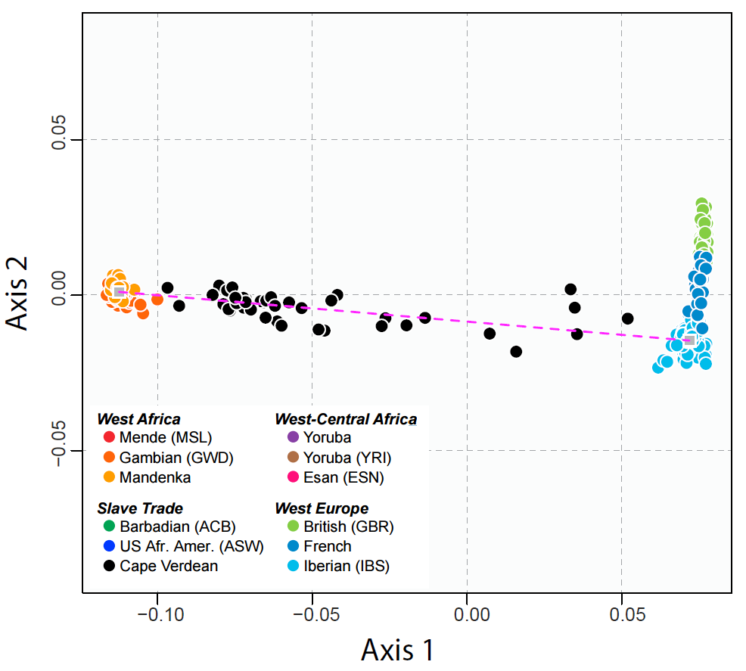
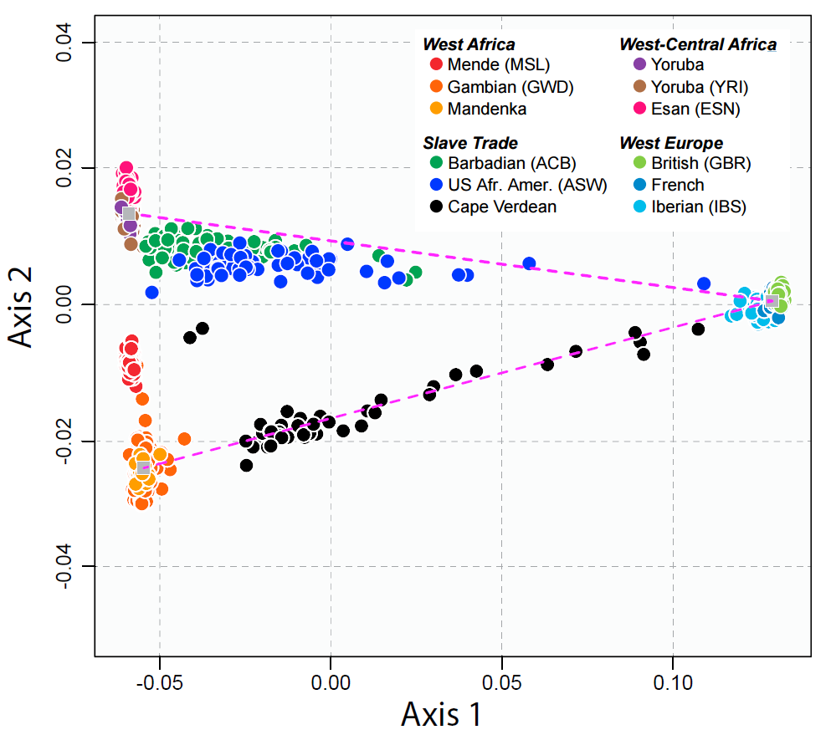
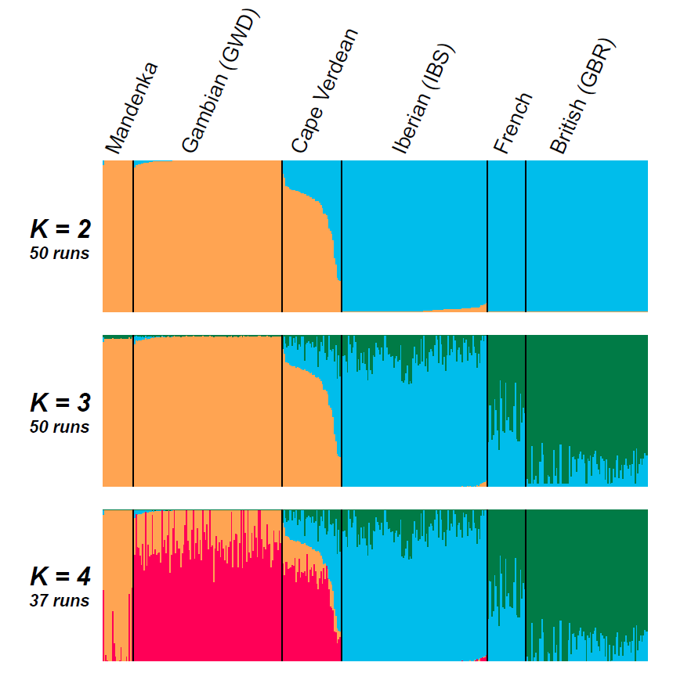
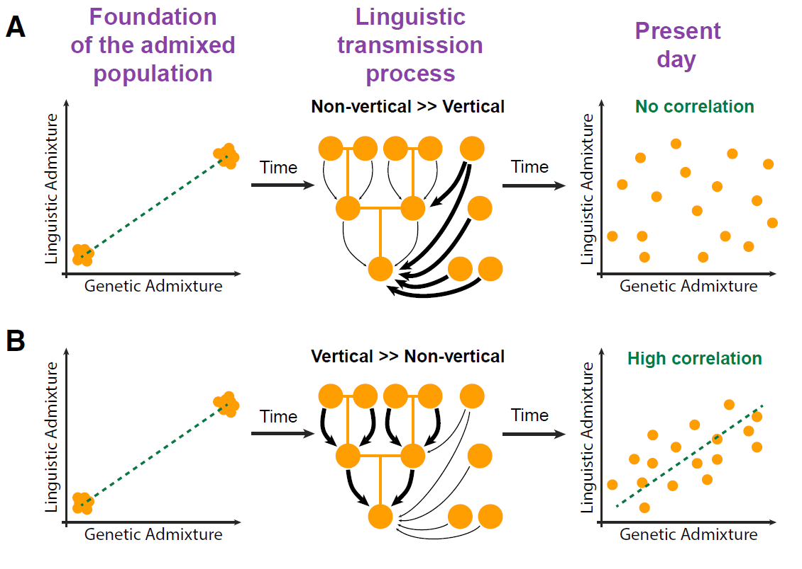
Bantu Migration | Model Analysis
Work published by Verdu et al. (2017) outlines the comparison of Creole (Cape Verdean) populations.
Methods:
2D multidimensional scaling to project the individual pairwise allele-sharing dissimilarities.
Unsupervised learning - repetitive clustering to infer admixture.
Notes:
1st MDS Plot: 2 W. African, 3 Euro, 1 Cape Verdean populations. Dotted line is the connection between the W. African and Iberian centroids.
2nd MDS Plot: 6 African, 2 W. Euro, 3 Slave-trade admixed population, Dotted line is the connection between Europeans with the West-Central African centroid and the centroid of Gambian Mandinka and Senegalese Mandenka.
Cluster Plot: Each line is an individual (399), 50 Admixture runs each (for K=2 to 4).

Slide 32
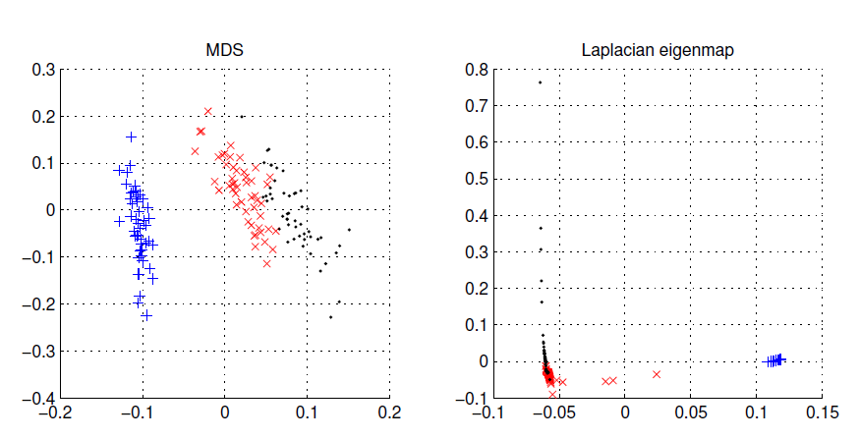
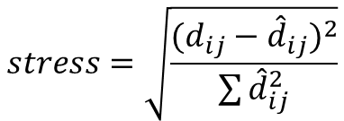
Dimensionality Reduction | MDS
Multidimensional Scaling
Input:
Correlation Matrix
Dimensionality (n to n-1)
Output:
n-dimensional coordinates
Minimize stress (≤0.05)
Cape Verdean
(Verdu, 2017)
Iris Data
(Alpaydin, 2014)
$$stress=\sqrt{\frac{{(d_{ij}−{\hat{d}}_{ij})}^{2}}{\sum{{\hat{d}}_{ij}^{2}}}}$$
Notes:
Use Feature Embedding to place in a low-dimensional map such that distances are preserved.
“PCA does the same work with MDS and does it more cheaply is d < N. PCA done on the correlation matrix rather than the covariance matrix is equivalent to doing MDS with standardized Euclidean distances where each variable has unit variance.”

Slide 33
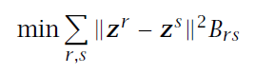
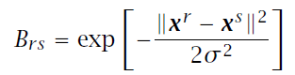
Dimensionality Reduction | LE
Let r and s be two instances and B_{rs} is their similarity, we want to find z^{r} and z^{s} that
B_{rs} can be defined in terms of similarity in an original space: 0 if x^{r} and x^{s} are too far, otherwise
Defines a graph to be Laplacian, and feature embedding returns z^{r}
Laplacian Eigenmaps
Input:
Correlation Matrix
Dimensionality (2 to 3)
Output:
n-dimensional coordinates
Uses k-NN or ε-NN and then Gaussian kernel to convert Euclidean distances to similarity measures.
Iris Data
(Alpaydin, 2014)
Notes:
Part of Manifold Learning: Manifold learning is an approach to non-linear dimensionality reduction. Algorithms for this task are based on the idea that the dimensionality of many data sets is only artificially high.
Came from Spectral Graph Theory

Slide 34
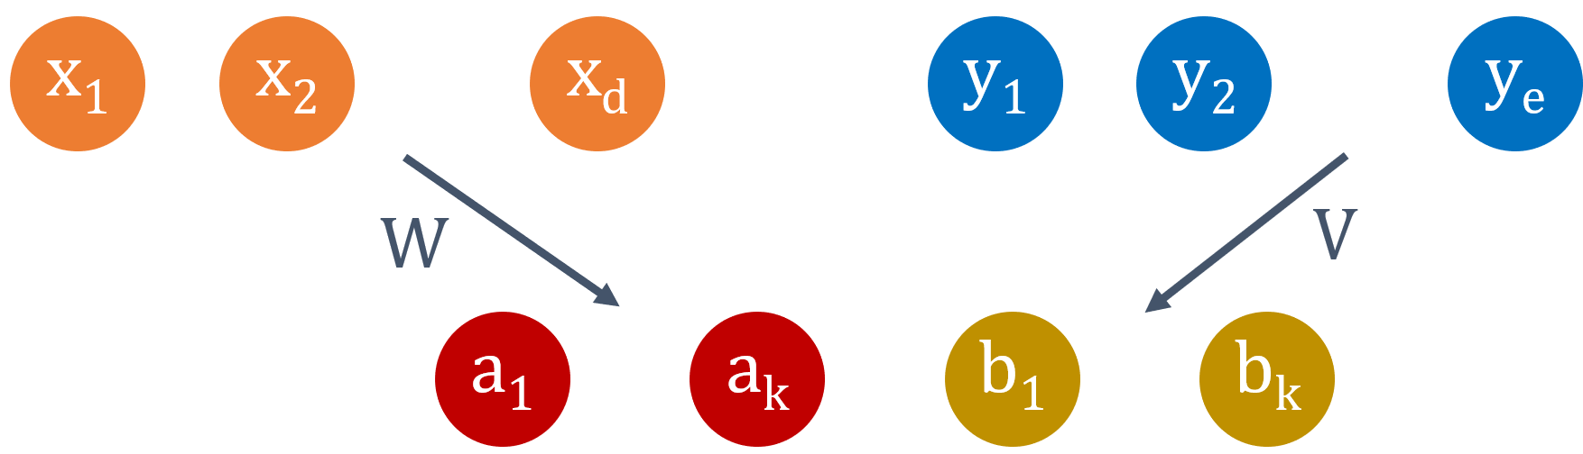
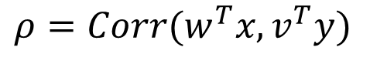
Dimensionality Reduction | CCA
Canonical Correlation Analysis
Input:
2+ Variable Sets
Output:
Projection set
Measures the amount of correlation between the x dimensions and the y dimensions.
Maximize the correlation, while keeping only the required number of eigenvectors
$$ρ=Corr(w^{T}x,v^{T}y)$$
Create two vectors w and v such that when x is projected along w and y is projected along v, we have the maximum correlation.
Notes:
Useful when you want to take the correlation of multiple variables sets into account when performing dimensionality reduction.

Slide 35
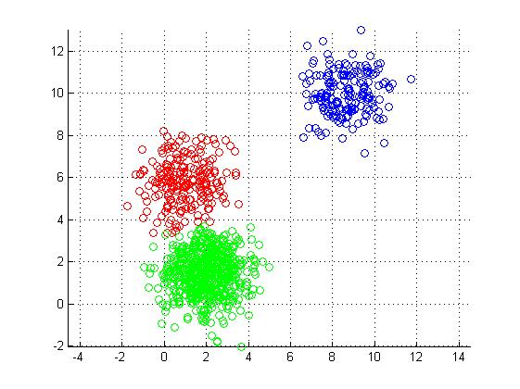

Dimensionality Reduction | k-Means Clustering
k-Means Clustering
Input:
Feature Matrix
Clusters (n to n-1)
Clusters data points based on relative distance
Allows you to view the average values of the variables to describe group characteristics
a
A
e
k
{\\o}
Cluster 1
\\=*A
Data points are assigned to clusters based on their mathematical distance from each other in the space
o
h
N
Cluster 2
b
f
t
Data points
w
Cluster 3
i

Slide 36
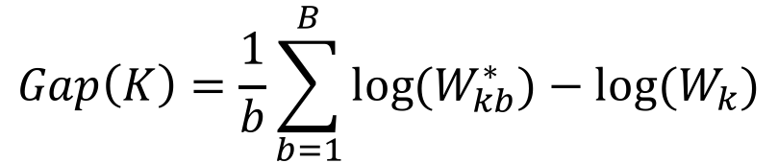
Dimensionality Reduction | Choosing k
Elbow Method
Gap Statistic
Sum of Squared Errors vs. k
Intra-cluster variation vs. k
$$Gap\left(K\right)=\frac{1}{b}\sum_{b=1}^{B}{{log⁡(W}_{kb}^{∗})−log⁡(W_{k})}$$
(Gove, 2017 [Link])

Slide 37
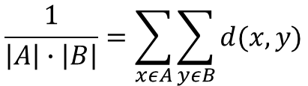
Dimensionality Reduction | UPGMA
Agglomerative (Bottom-Up) Hierarchical Clustering
Distances to Trees Conversion
To visually compare the results of the dimensionality reduction methods to the phylogenetic trees, I will need to turn the results into trees.
Compute the distance matrices of the results and use UPGMA
Input:
Distance matrix
Output:
Dendrogram of the combined objects
Recursively combines objects based on pairs with minimum distances. Then, recomputes the entire distance matrix to compare each object to the combined objects.
$$\frac{1}{\left|A\right|∙\left|B\right|}=\sum_{xεA}{\sum_{yεB}{d(x,y)}}$$
Notes:
DEMO
Unweighted Pair Group Method with Arithmetic Mean

Slide 38
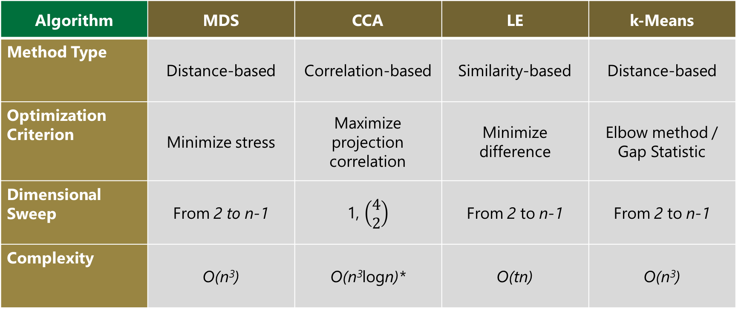
Dimensionality Reduction | Comparison
Algorithm | MDS | CCA | LE | k-Means
Method Type | Distance-based | Correlation-based | Similarity-based | Distance-based
Optimization Criterion | Minimize stress | Maximize projection correlation | Minimize difference | Elbow method / Gap Statistic
Dimensional Sweep | From 2 to n-1 | 1, $\left(\begin{matrix}4 \\ 2\end{matrix}\right)$ | From 2 to n-1 | From 2 to n-1
Complexity | O(n³) | O(n³logn)* | O(tn) | O(n³)
(Cayton, 2005)
Notes:
LE: O(tn), t=Dimensions

Slide 39


Visualization | Software
(Tableau Software, 2013 [Link])
NVector
(Plot.ly, 2017 [Link])
(Janies et al., 2011 [Link])
(Wickham, 2009 [Link])
(Chang et al., 2017 [Link])
(Vaidyanathan, 2014 [Link])

Slide 40
Bantu Migration Analysis using Y-Chromosomal, Mitochondrial, and Linguistic Information
Goals:
Provide a prediction of the Bantu Migration using Paternal, Maternal, and Linguistic data.
Support or Reject claims made by previous researchers around their expansion prediction.
Use methods outlined in Verdu et al. (2017) to validate the predicted migratory pattern.
Background Information:
Researchers from linguistics have posed migratory patterns for the Bantu people.
Linguistic: Drs. Grollemund and Currie
Genetic and Linguistic: Dr. de Fillipo
There are considerable differences between these methods.
Complementary to work being completed by Dr. Jia Wen and Conor Nodzak at UNCC.

Slide 41
Closing Remarks
Milestones/Deliverables:
Create individual and combined trees
Combine geographic data to project the phylogeny on a map
Utilize dimensionality reduction methods for comparison/support of the combined model
Test the early-split hypothesis of Bantu migration using these findings
Understanding human variation is a complex topic that has roots in many fields (such as biology, genomics, sociology, psychology, and linguistics).
Only using one type of data completely disregards other complexity.
I will show the importance and utility of integrating data to create a more robust Bantu migratory model.
Also, I will analyze the data using dimensionality reduction methods for visual comparison to build support for the model.

Slide 42


Special Thanks
Committee Members
Funding and Support Sources
Dr. Daniel Janies
Carol Grotnes Belk Distinguished
Professor of Bioinformatics and Genomics
Dr. Xinghua Shi
Assistant Professor of Bioinformatics and Genomics
Dr. Anthony Fodor
Professor of Bioinformatics and Genomics
Dr. Mirsad Hadzikadic
Professor of Software and Information Systems
Dr. Matthew Parrow
Associate Professor of Biology
Wayland H. Cato Jr. Doctoral Fellowship
Tuition support and Stipend
Microsoft
Software licenses, Azure resource credits
BlueGranite, Inc.
Consultative expertise, Professional development support

Slide 43
Questions? …and Thank you!

